Slide 1
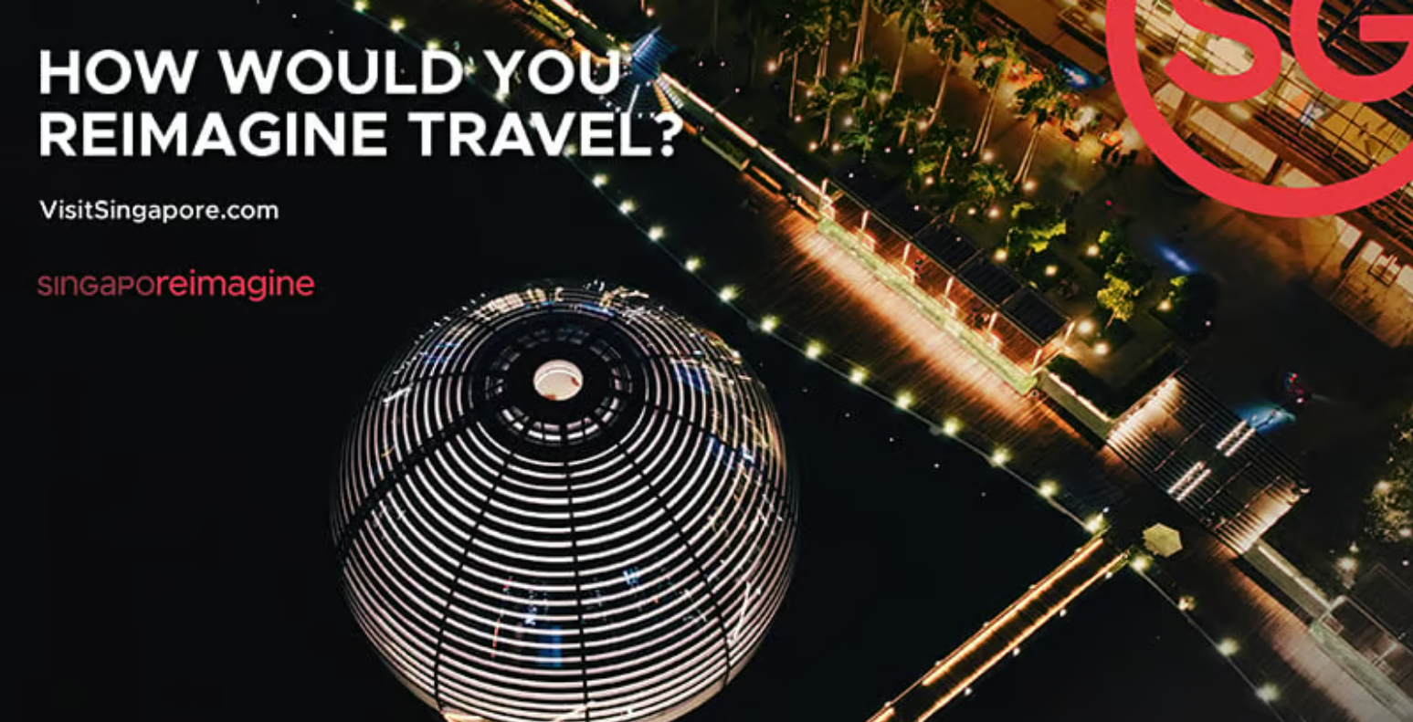
https://www.meetingspotlight.com/article/singapore-launches-singaporeimagine-it-looks-ahead-future-travel

Slide 2

Agenda
Situation
Findings
Recommendation

Slide 3
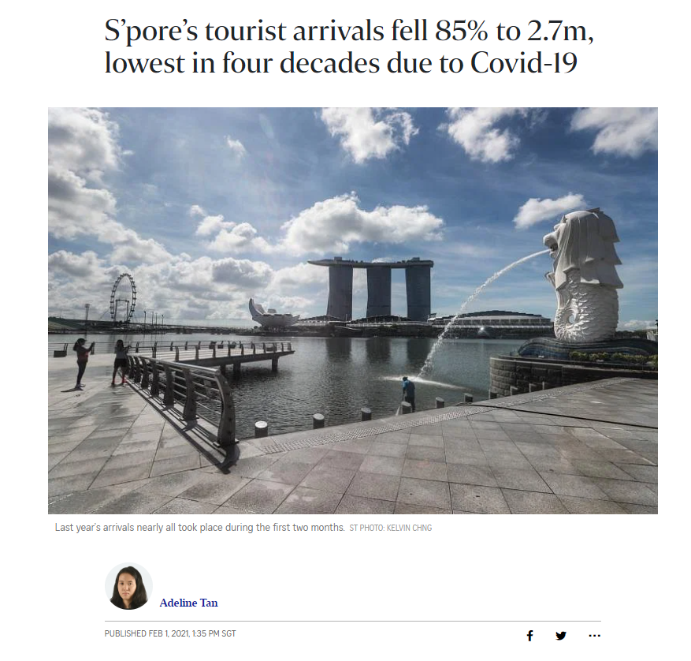
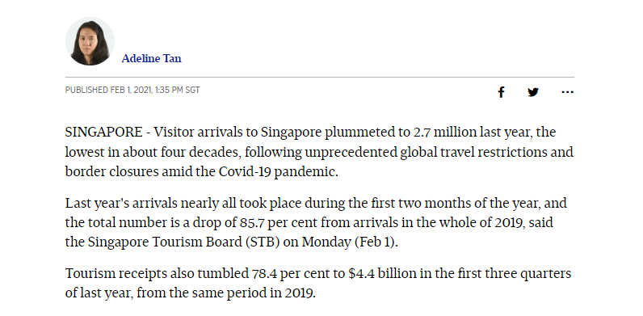
Situation
https://www.straitstimes.com/singapore/consumer/27-million-visitors-in-singapore-in-2020-lowest-in-four-decades-due-to-covid-19
Notes:
In this slide, you see eye-catching article that paints the picture of the current tourism arrivals for Singapore. “Tourism arrivals fall by 85% due to covd

Slide 4
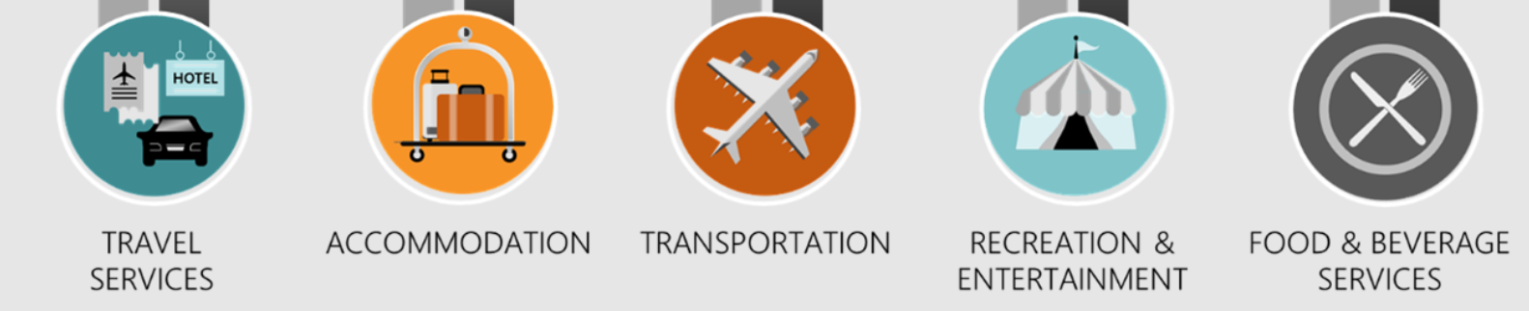
Complication on loss in Visitor Arrivals
Drop in visitor arrival
Loss in Tourism Receipts
Loss in GDP
Loss in Jobs/Income
https://www.iseas.edu.sg/wp-content/uploads/2021/07/ISEAS_Perspective_2021_108.pdf
Notes:
Tourism contribution to GDP is around 4% over the yearsbut covid had bring it to almost 0% contribution due to lost in visitor arrivals. Tourism contributes to the Singapore economy by increasing the demand for goods and services through tourist receipts. Tourism receipts can be segregated into different categories lke travel services, accommodation, transportation, recreation like gaming and F&B

Slide 5
Resolution
Using Rainfall data & Visitor arrival data from 1996 to 2015
Organize right strategic tourism events
On the right month
To the right visitors
Boost Singapore’s tourism arrivals.
Notes:
This project aims to analyse trends in Singapore weather and visitor arrivals to identify how rainfall affects visitor arrivals. This analysis can help leverage monsoon data and visitors’ arrival data in deciding when is best to organize strategic tourism events to boost Singapore’s tourism arrivals.

Slide 6
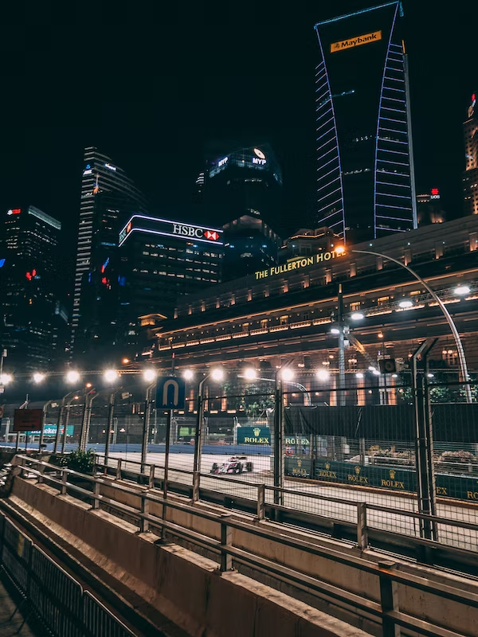
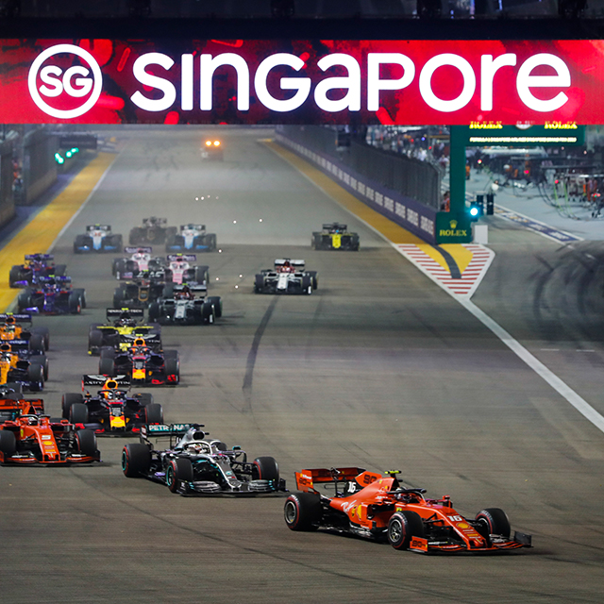
https://unsplash.com/photos/jvp_lZydFWc
https://www.visitsingapore.com/festivals-events-singapore/annual-highlights/grand-prix-season-singapore/
Notes:
Here is a quick example on how a right event at the time can have on the right effect on visitor arrivals

Slide 7
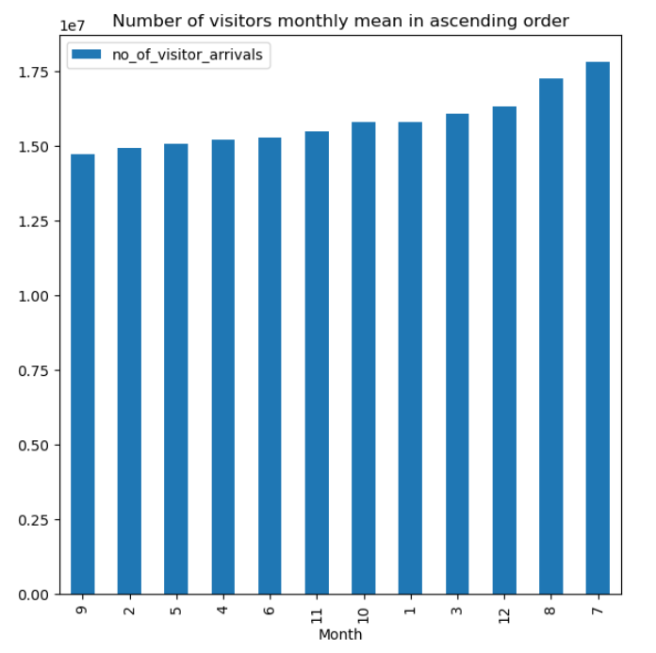
https://www.visitsingapore.com/festivals-events-singapore/annual-highlights/grand-prix-season-singapore/
https://data.gov.sg/
Notes:
Do you know that September has the lowest visitor arrivals for the past years so it's not coincidental why STB planted F1 in September

Slide 8
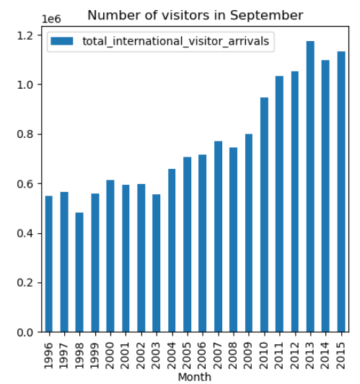
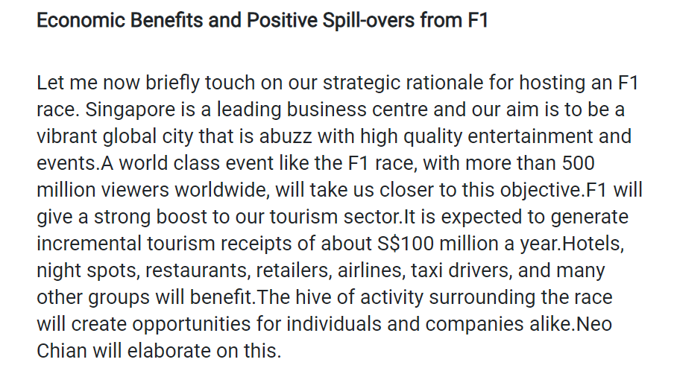
https://www.mti.gov.sg/Newsroom/Speeches/2007/05/Opening-Remarks-by-MOS-Iswaran-on-the-Formula-1-Singapore-Grand-Prix
Notes:
F1 started in year 2008 and the chart here shows the significant increase in visitors after the introduction of F1 from 2010
right strategic tourism events
On the right month
To the right countries

Slide 9
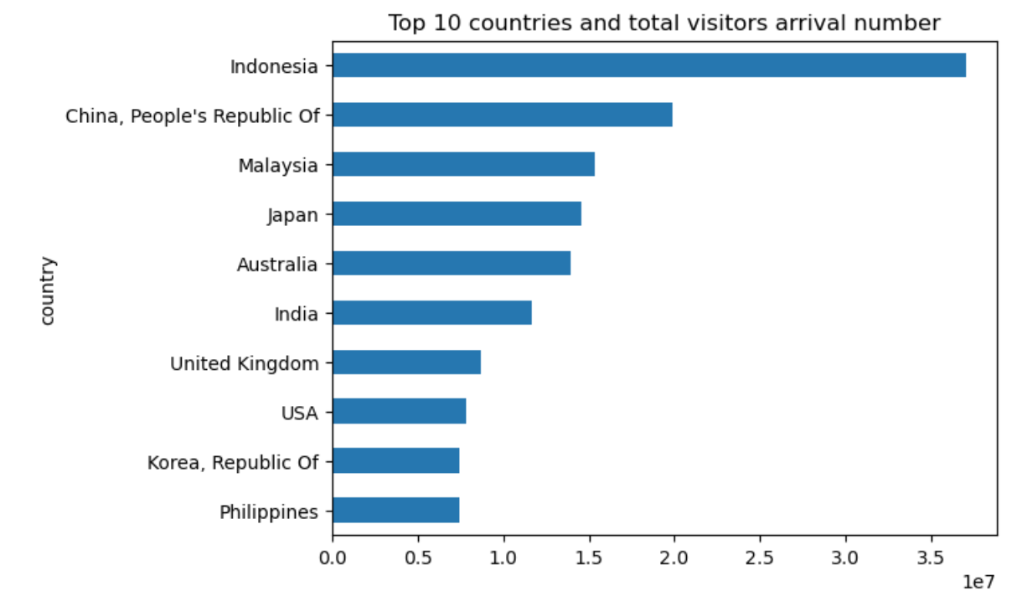
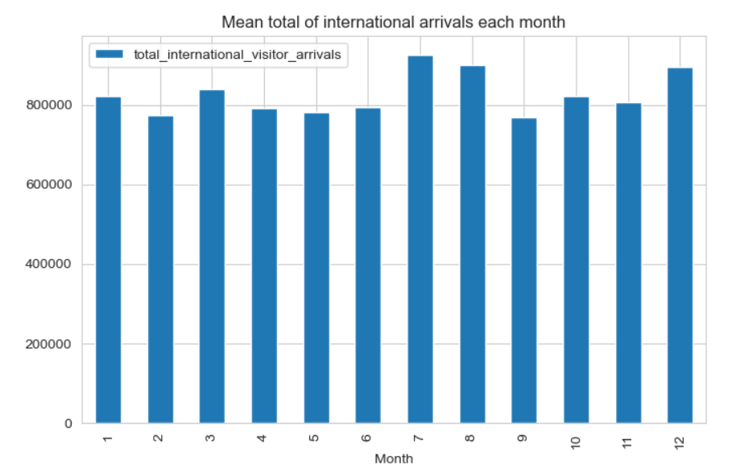
Insight : most popular months + top visitors’ countries
Notes:
We analyze the data of visitors arrival from 1996 - 2016 (20 years)
From the chart above, most tourists came from Oceania and Asia
And this trend seems to be quite consistent over the decades.
Notice that in the most recent decade (2010s), Asian tourists has surpassed Oceania visitors arrival
Digging deeper, the highest arrivals are from Indon, China, MY, Japan and Australia
And this trend is consistent over the years
PRC visitors climbed the most, from the lowest among the top 5 countries, the number 2 after Indonesia
SARS happened in 2003, hence a sharp fall

Slide 10
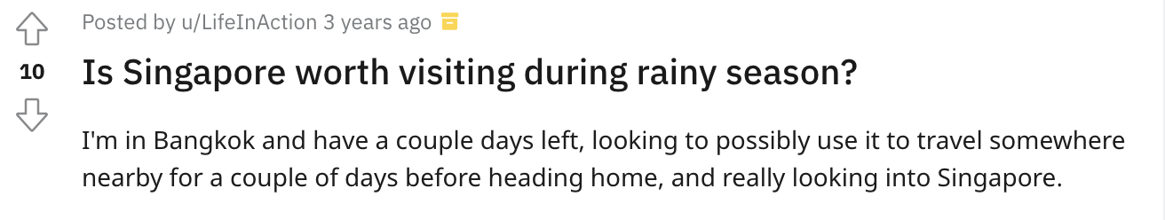
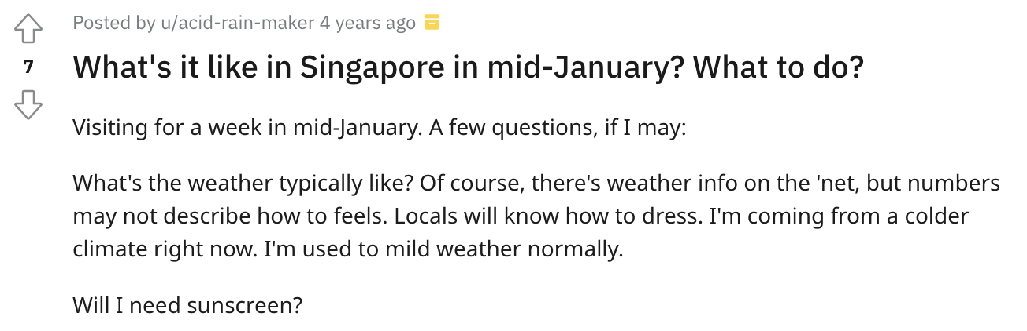
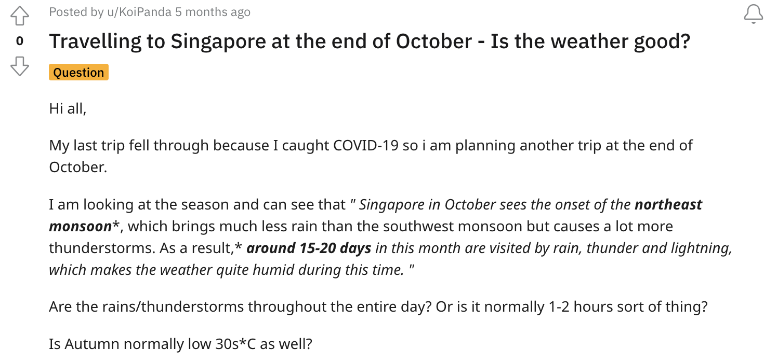
Notes:
You can see that

Slide 11
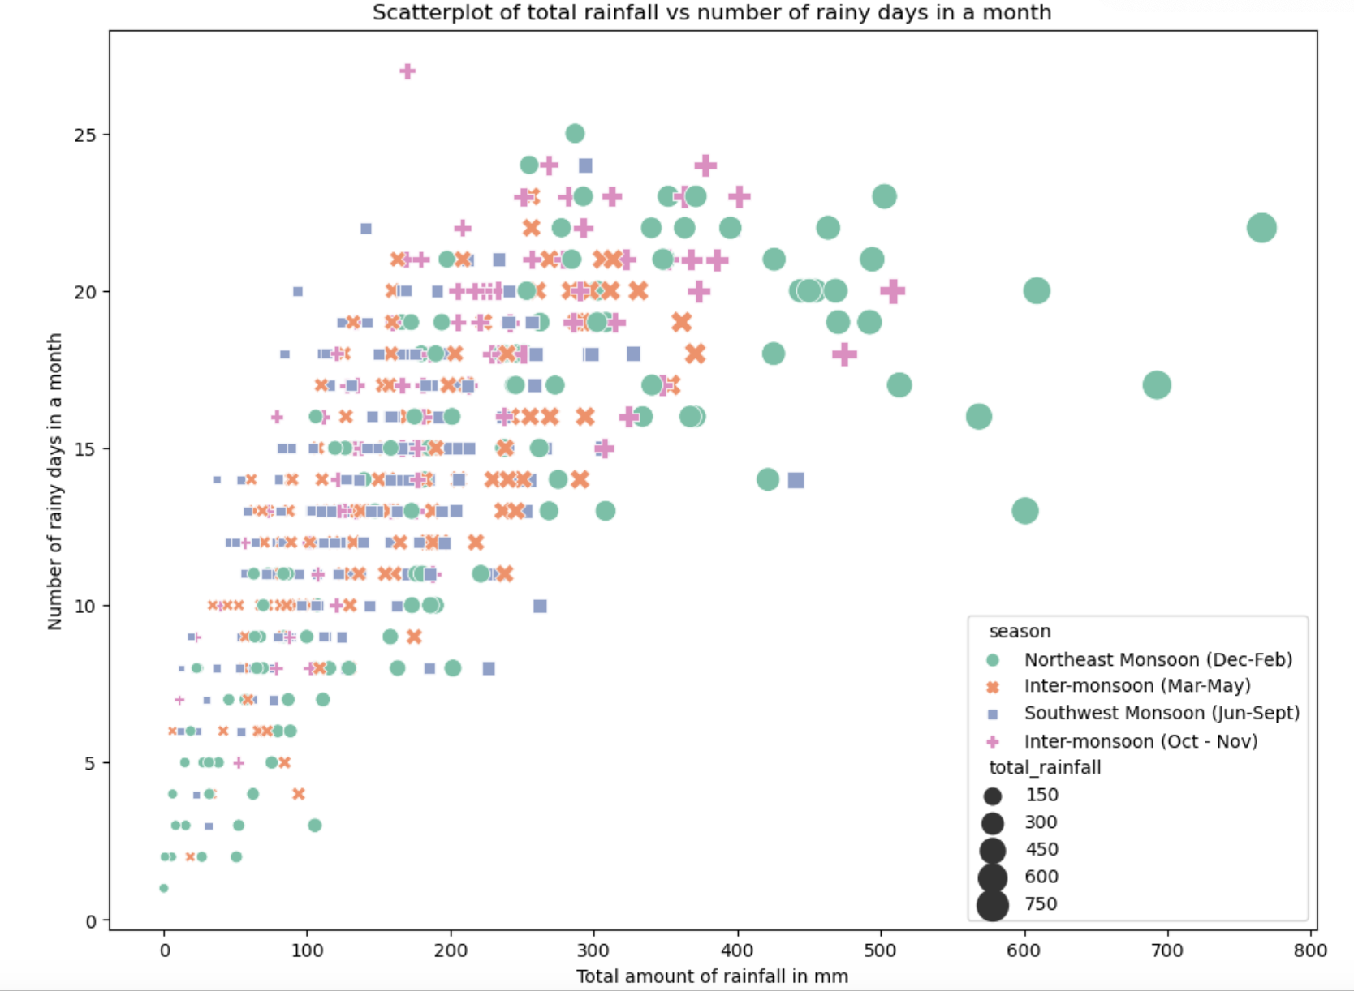
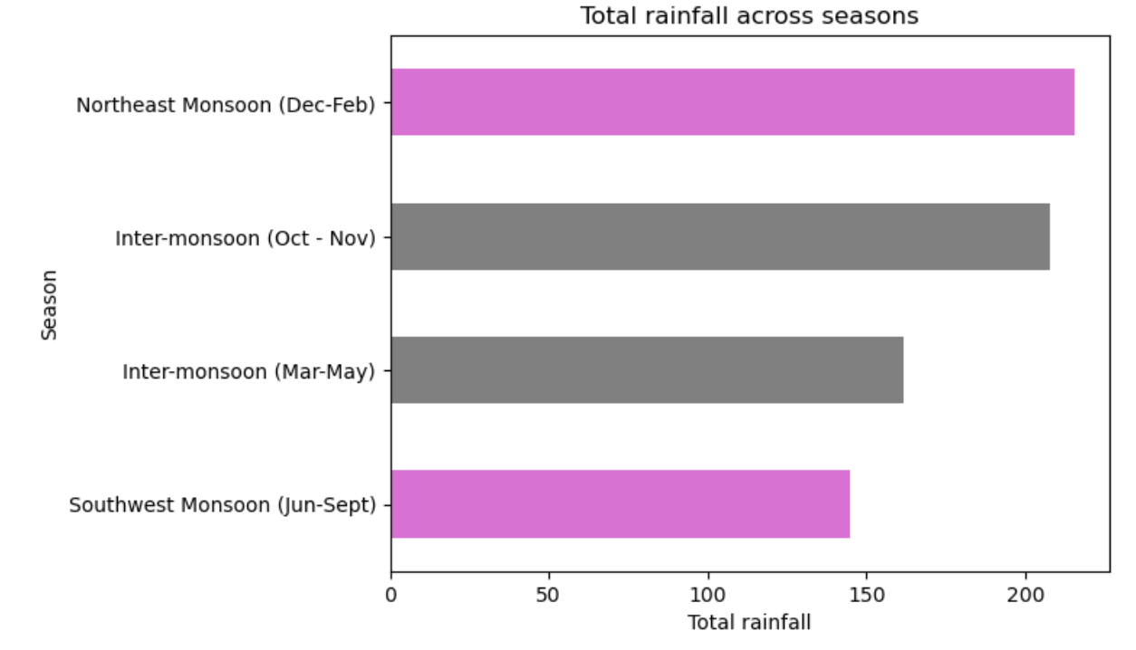
An analysis on Singapore’s weather
Notes:
Your next question might be: is there such a thing as rainy season in Singapore? Since temperature and humidity is almost the same, and there is not a lot of freaky weathers like other countries
Yes! There is. Dec - Feb is what we called the ‘Northeast Monsoon season’. Even two months before, it begins to rain a lot.
And this pattern is consistent over the decades.
Need to label the first chart oops
Perhaps make the second chart’s northeast and inter-monsoon speak out with specific colors
And it is not just the amount of rainfall that is more significant during this period, the number of rainy days too!

Slide 12
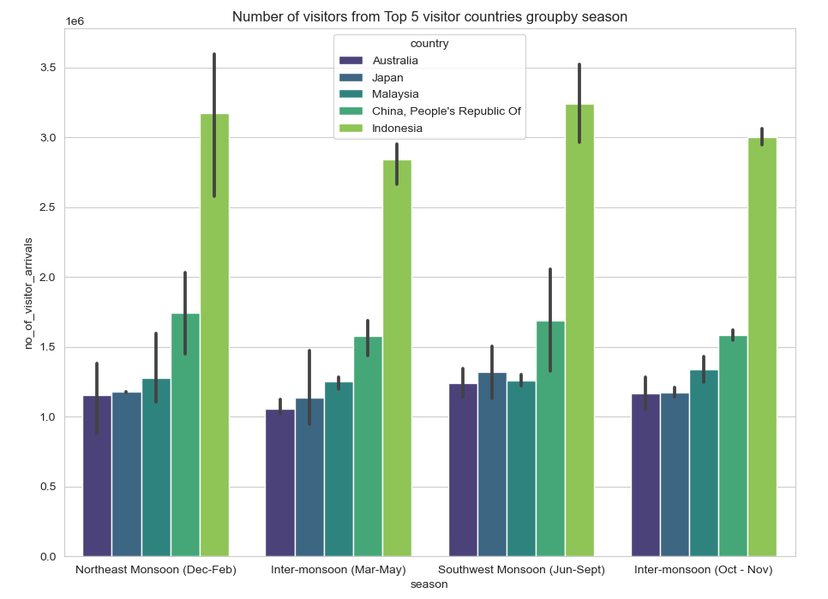
Top 5 Countries’ visitors by monsoon season
Indonesian and Chinese visitors are the highest throughout the seasons
More Japanese and Australian visitors during Jun-Sept period than the rest of the year
Notes:
Most number of visits happen during Northeast Monsoon (Dec-Feb) and Southwest Monsoon season (Jun-Sept).
Throughout the seasons, Indonesians remain the highest visitors, followed by Chinese tourists.
There are more Japanese and Australian visitors during Southwest Monsoon season (compared to their visits during the rest of the year)

Slide 13
Our Strategy:
Curate the right strategic tourism events for the right visitors’
during the right period

Slide 14
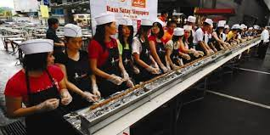
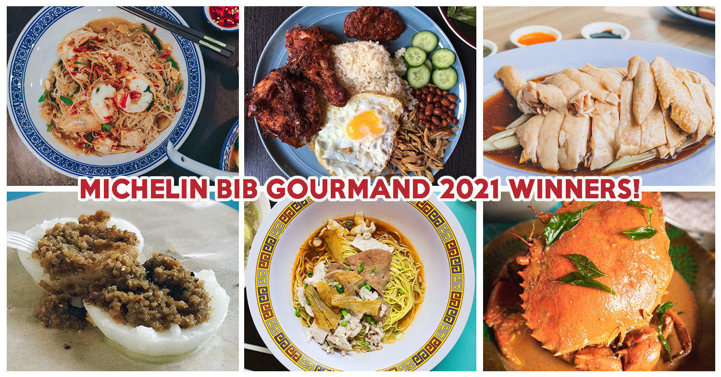
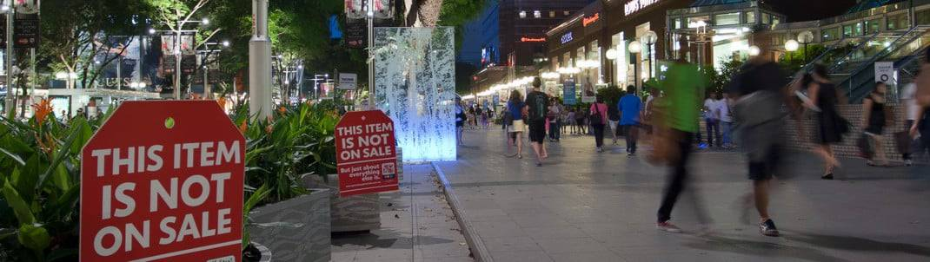
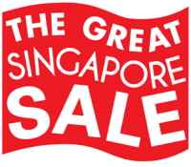
Jun - Sept : Eat and Shop in Sunny Singapore
Guinness World Record for Longest Satay Line
https://www.guinnessworldrecords.com/world-records/longest-satay
Singapore Food Trails
Note: Japanese tourists comes in tour buses and loves our food https://www.straitstimes.com/singapore/singapore-back-on-japanese-tourists-map-0
https://eatbook.sg/michelin-bib-gourmand-2021/
https://boncode.sg/sg/store/great-singapore-sale/
Great Singapore Sales

Slide 15
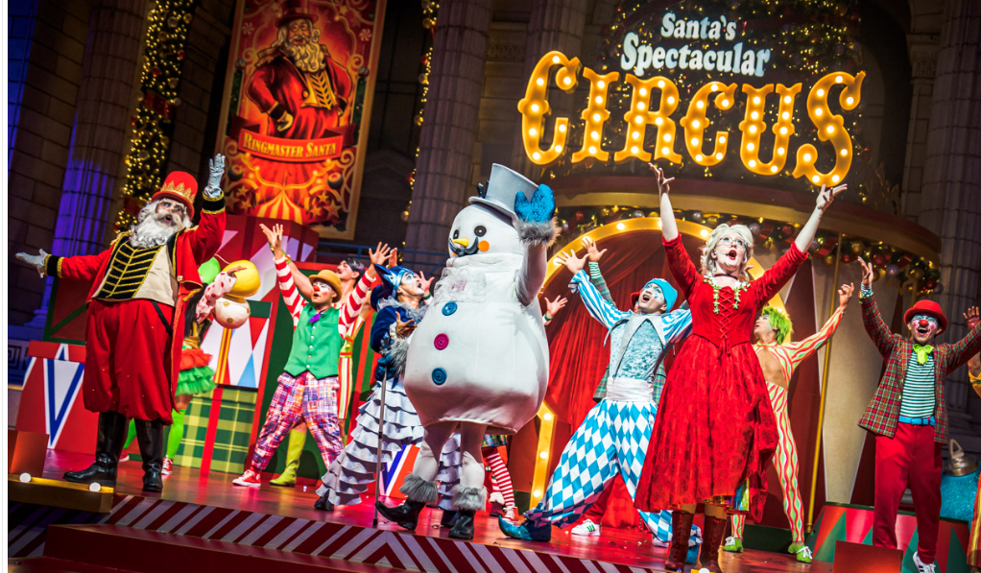
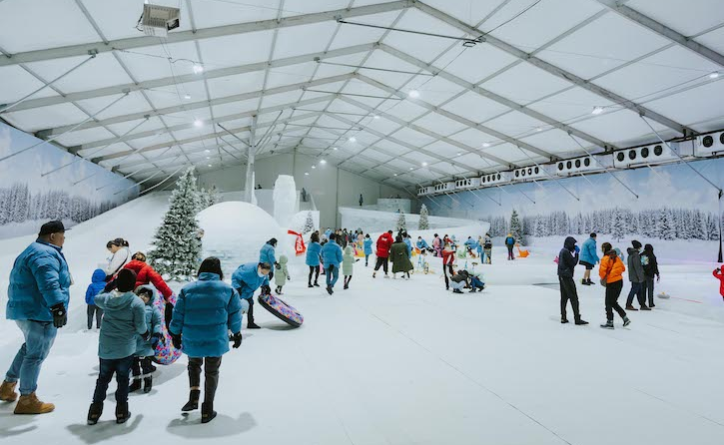
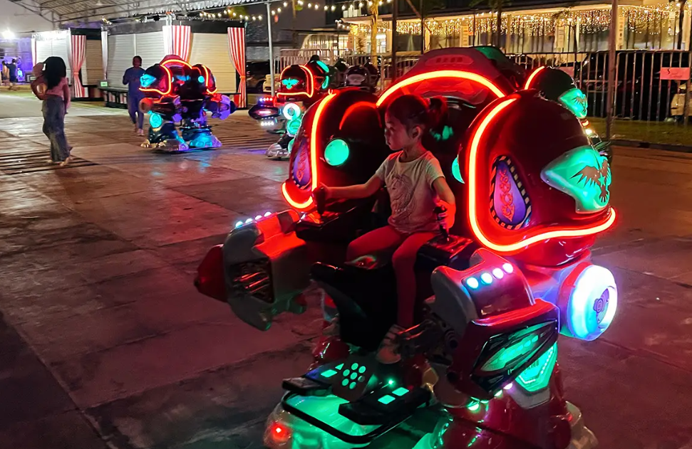

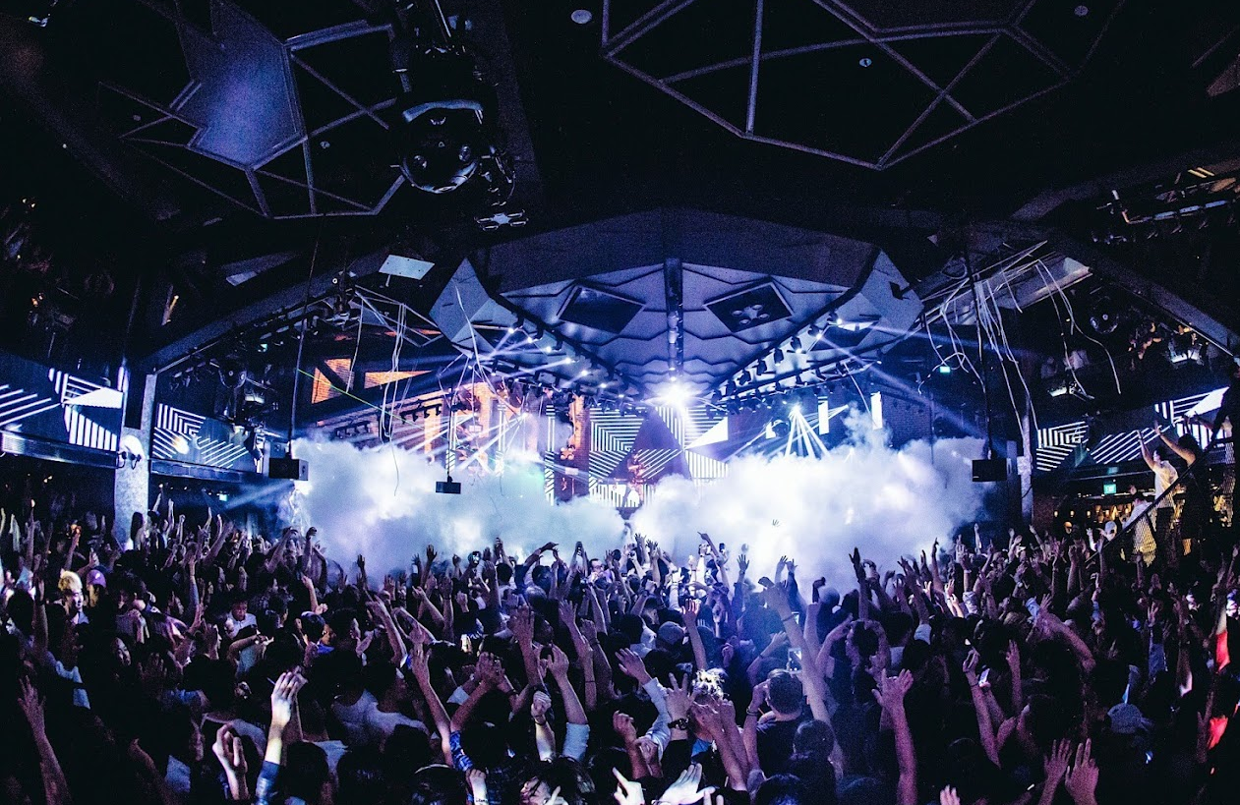
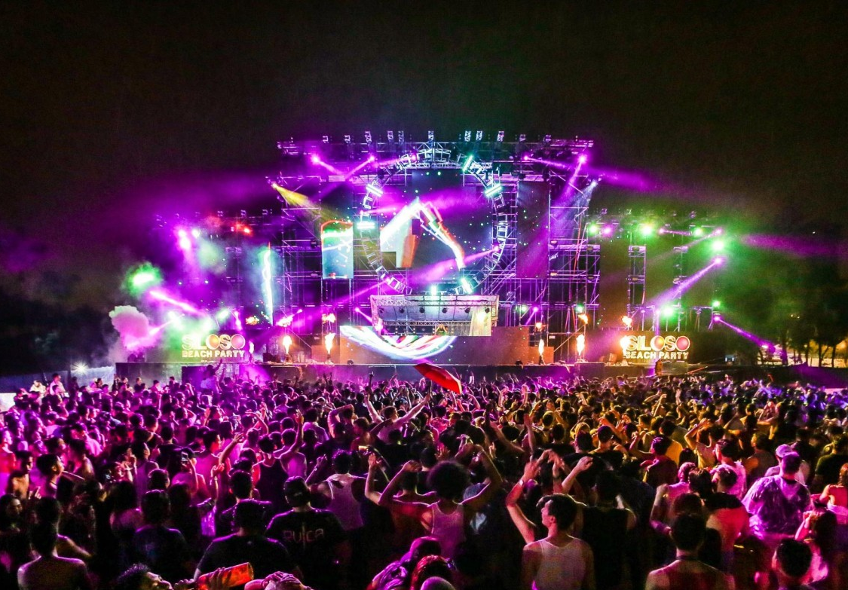
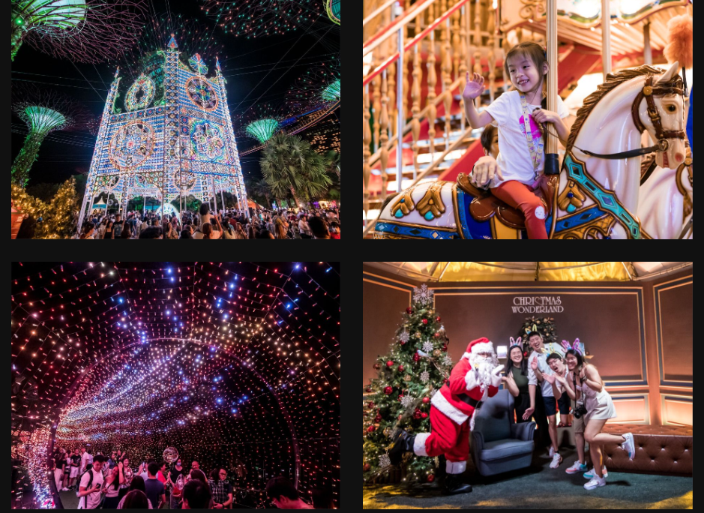

Dec - Feb : An Event for Everyone
https://dejiki.com/2022/12/uss-universal-christmas-2022-event/
https://www.sassymamasg.com/the-great-bay-fiesta-at-marina-bay/
https://www.sunnycitykids.com/latest/mega-carnival-at-dmarquee-downtown-east
Musical, circus and carnivals
Skate with family
Mega Carnival Downtown East
https://www.zoukout.com/looking-back/
https://thesmartlocal.com/read/siloso-beach-party-2018/
https://christmaswonderland.sg/
Zouk Out
Siloso Beach Party
Christmas Wonderland

Slide 16

Potential enhancements
The current data set only shows visitors arrivals, and not spending
Not all visitors are big spenders
Spending gives a better idea on which country’s tourists are giving the most return
To assign weightage to countries
based on proximity of their countries to Singapore

Slide 17
Thank you
Q&A

Slide 18
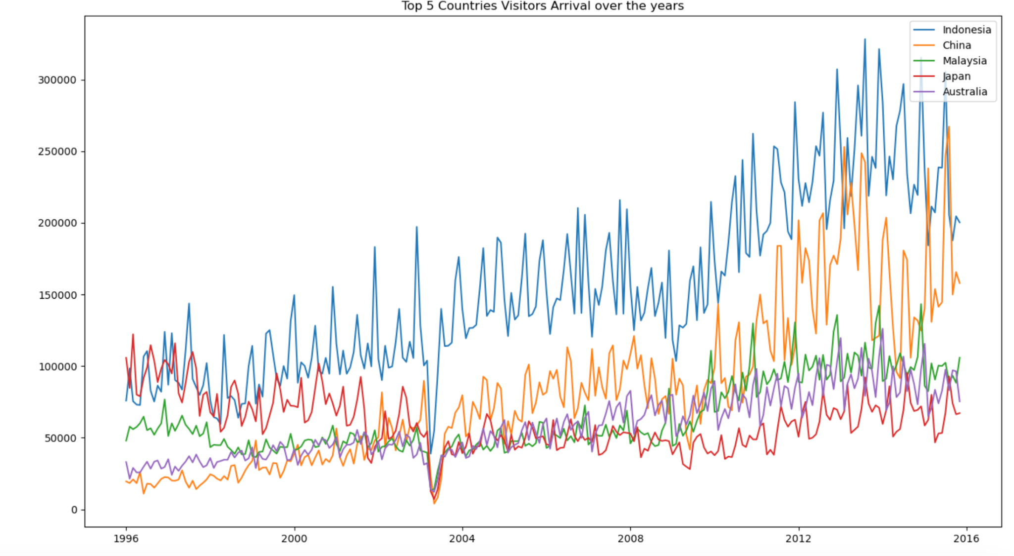

Slide 19
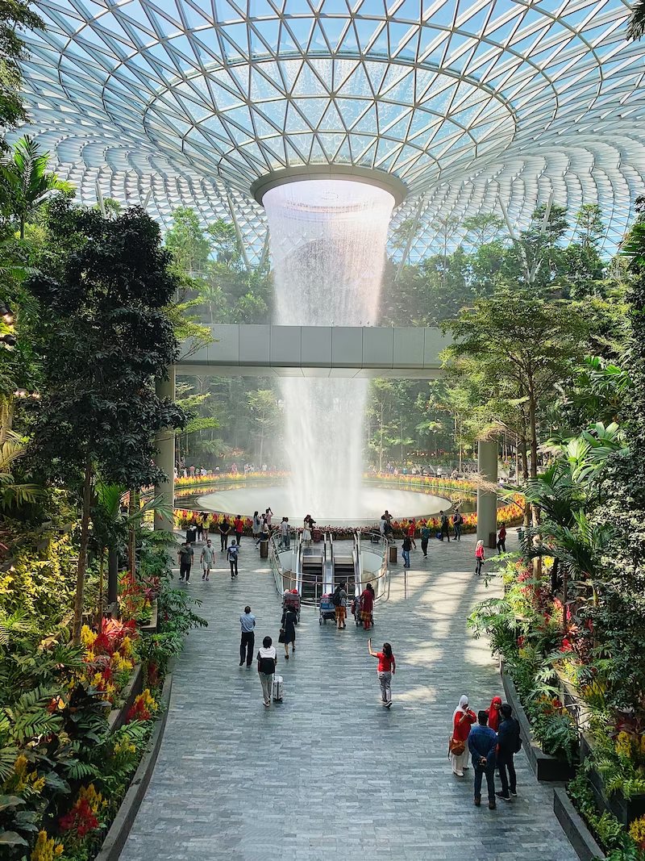
Problem statement
We are a group of data analysts from STB. As the borders open up, we are thinking of optimizing our budgets to advertise Singapore to the world.
We would like to explore the question: Is it possible to target the right audience?
The benefit of doing so is to generate relevant contents and activities for the tourists from top visiting countries.
Notes:
We are a group of data analysts from STB. As the borders open up, we are thinking of optimizing our budgets to advertise Singapore to the world.
We would like to explore the question: Is it possible to target the right audience?
The benefit of doing so is to generate relevant contents and activities for the tourists from top visiting countries

Slide 20
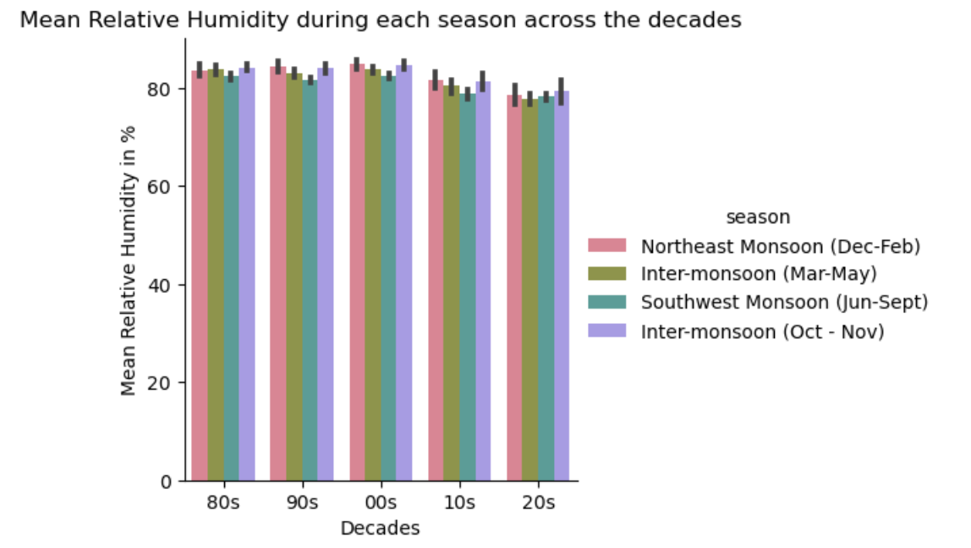
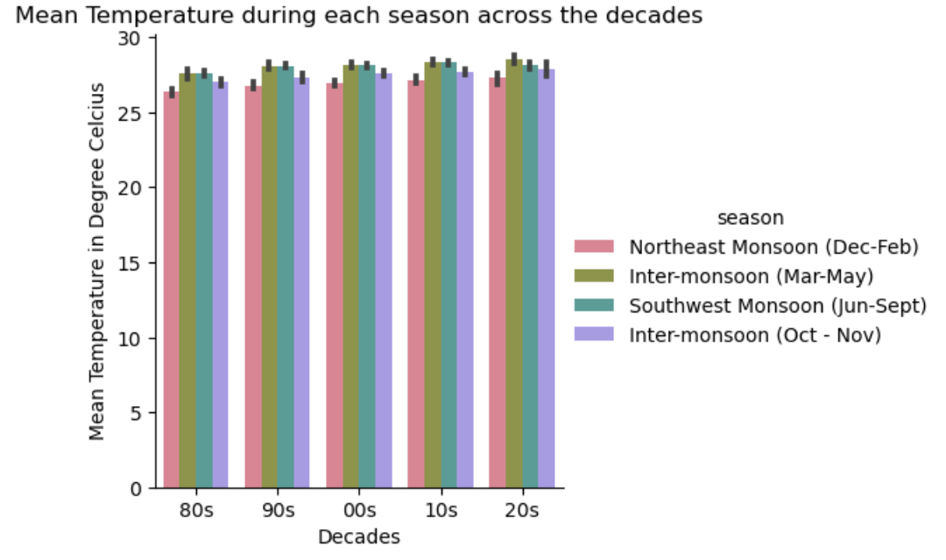
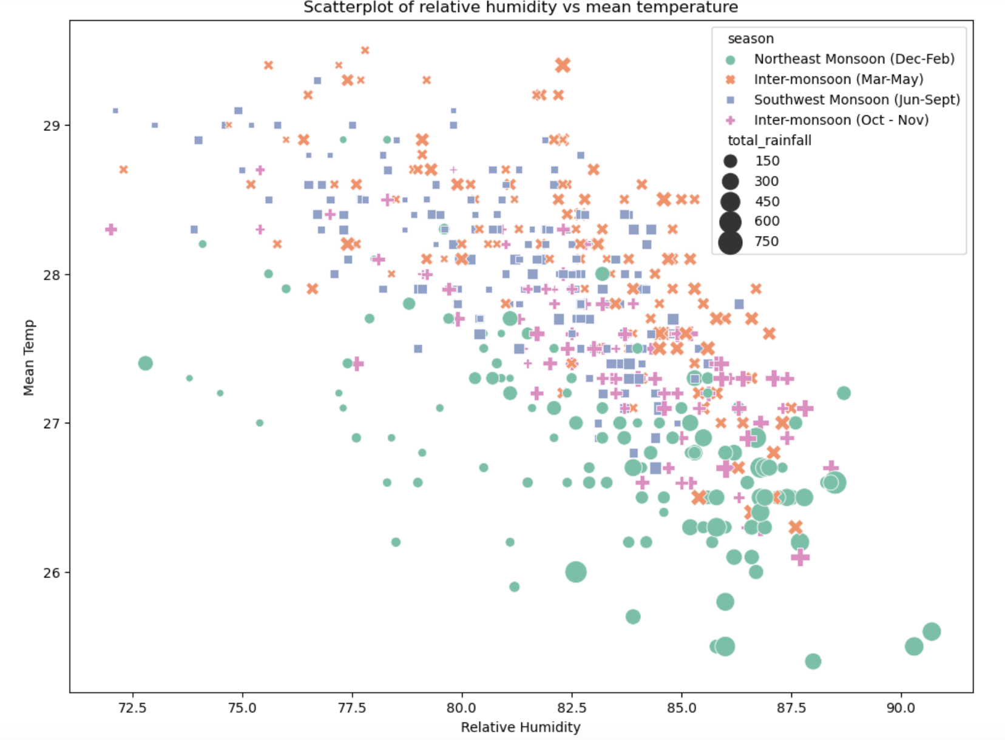
Weather and Humidity are constant across decades
Northeast Monsoon is the most cooling temperatures but will be very rainy
Almost no difference on the temperature and humidity
This pattern is common across the decades
Singapore’s weather is not as
Notes:
Singapore has a pretty stable weather when it comes to humidity and temperature
Most time of the year, it will be quite warm (mean temp: AXYZ) and quite humid (mean humidity: ADKJSF)
So when you visit Singapore, even if you don’t encounter rain, you will still sweat a lot

Slide 21
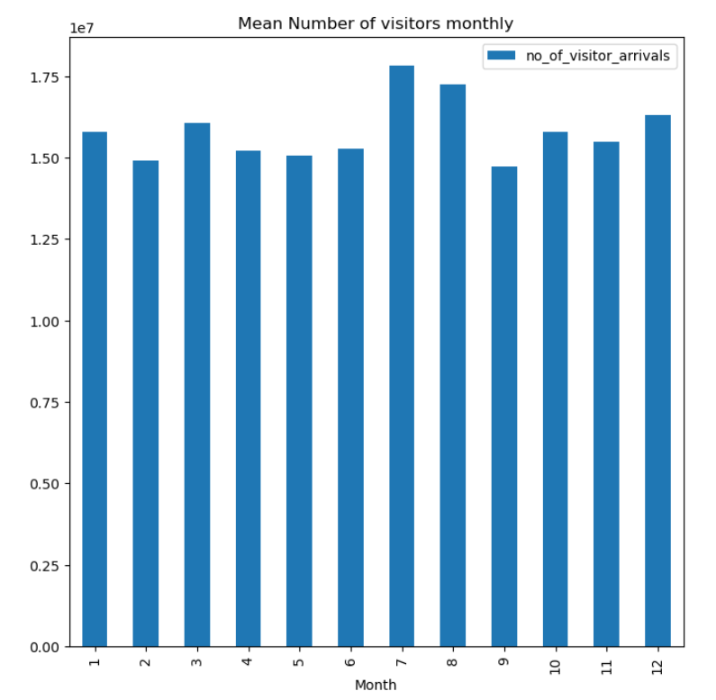

Slide 23
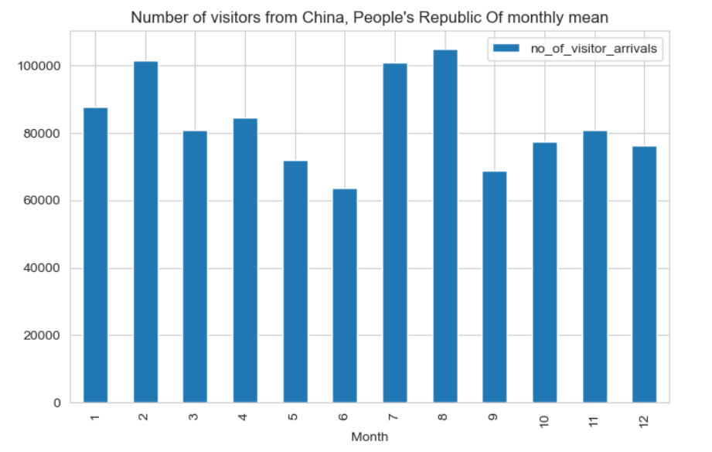
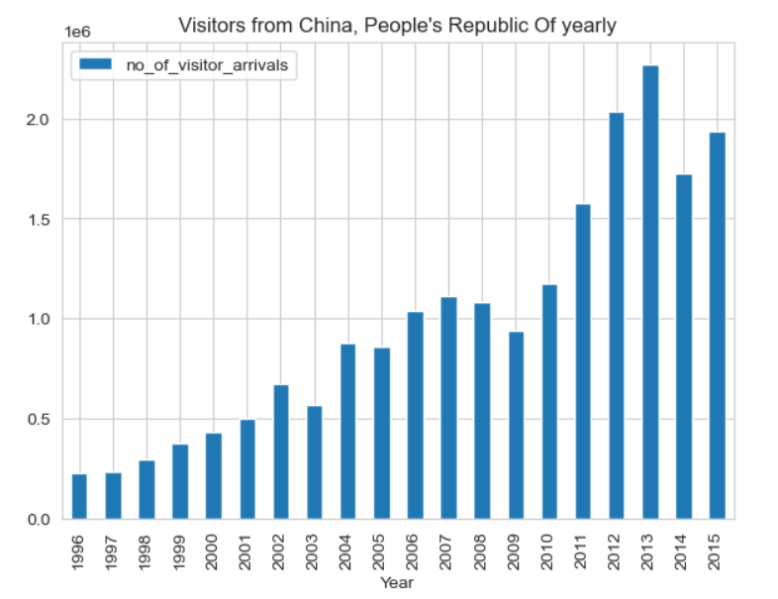

Slide 24

Problem statement #2
Govt is urging us to get a 4th booster, perhaps due to the upcoming festive seasons and the recent announcement of China’s reopening.
Unlike previous times, I receive more than 1 reminder/invitation to get a shot. This means the take up rate for this booster has been lower than necessary.
Hence we would like to explore the question: Do we need to have a bivalent vaccine shot urgently?

